Slide 1
Machine Learning
Lecture 19c: Unsupervised Clustering (III): Gaussian Mixture Model
Dr. Beilun Wang
Southeast University
School of Computer Science
and Engineering

Slide 2
Course Content Plan
Regression (supervised)
Classification (supervised)
Unsupervised models
Dimension Reduction (PCA)
Clustering (K-means, GMM/EM, Hierarchical )
Learning theory
Y is a continuous
Y is a discrete
NO Y
About f()
Graphical models
About interactions among X1,… Xp
Reinforcement Learning
Learn program to Interact with its environment

Slide 3



What is clustering?
Find groups (clusters) of data points such that data points in a group will be similar (or related) to one another and different from (or unrelated to) the data points in other groups
Inter-cluster
distances are maximized
Intra-cluster distances are minimized

Slide 4
Roadmap: Clustering
Definition of "groupness"
Definition of "similarity/distance"
Clustering Algorithms
Hierarchical algorithms
Partitional algorithms
Formal foundation and convergence
How many clusters?

Slide 5
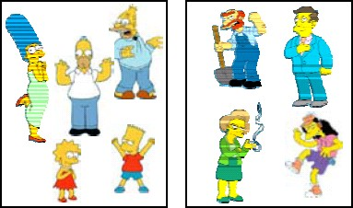
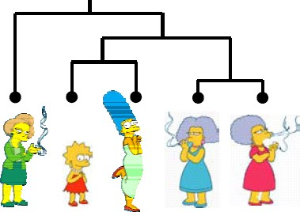
Clustering Algorithms
Partitional algorithms
Usually start with a random (partial) partitioning
Refine it iteratively
K means clustering
Mixture-Model based clustering
Hierarchical algorithms
Bottom-up, agglomerative
Top-down, divisive

Slide 6
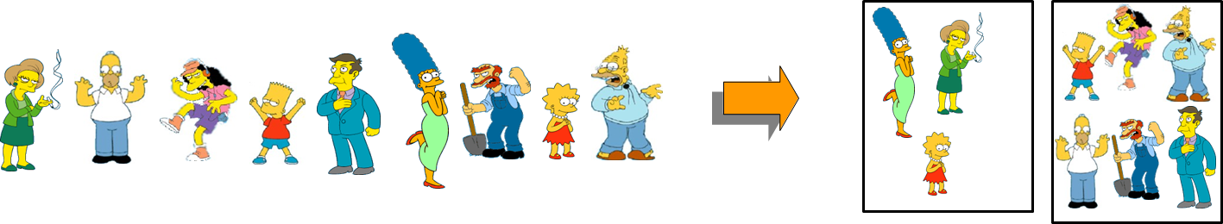
Partitional Clustering
Nonhierarchical
Construct a partition of n objects into a set of K clusters
User has to specify the desired number of clusters K.

Slide 7
Other partitioning Methods
Partitioning around medoids (PAM): instead of averages, use multidim medians as centroids (cluster “prototypes”). Dudoit and Freedland (2002).
Self-organizing maps (SOM): add an underlying “topology” (neighboring structure on a lattice) that relates cluster centroids to one another. Kohonen (1997), Tamayo et al. (1999).

Slide 8
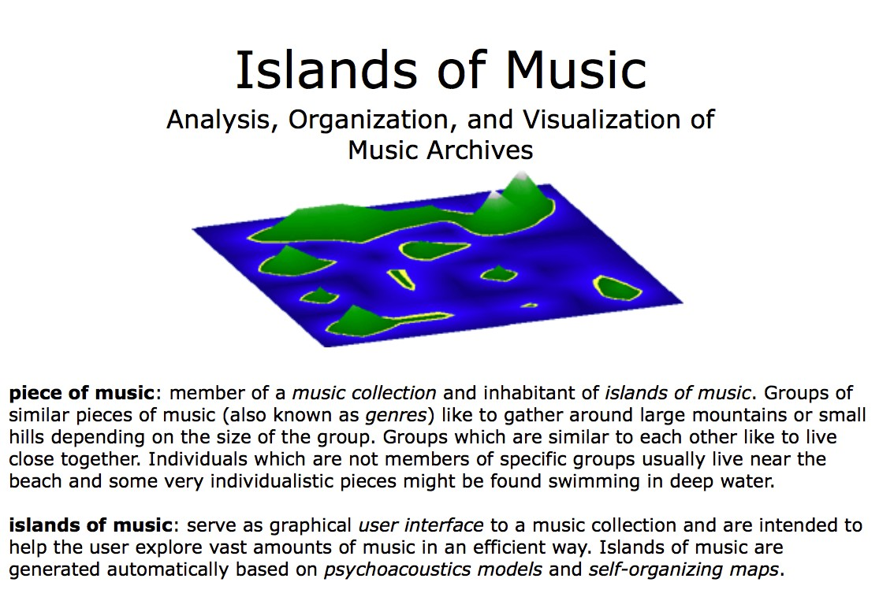
E.g. SOM Used for Visualization
Islands of music (Pampalk et al., KDD’ 03)

Slide 9


Other partitioning Methods
Partitioning around medoids (PAM): instead of averages, use multidim medians as centroids (cluster “prototypes”). Dudoit and Freedland (2002).
Self-organizing maps (SOM): add an underlying “topology” (neighboring structure on a lattice) that relates cluster centroids to one another. Kohonen (1997), Tamayo et al. (1999).
Fuzzy k-means: allow for a “gradation” of points between clusters; soft partitions. Gash and Eisen (2002).
Mixture-based clustering: implemented through an EM (Expectation-Maximization)algorithm. This provides soft partitioning, and allows for modeling of cluster centroids and shapes. (Yeung et al. (2001), McLachlan et al. (2002))

Slide 10
Today: Gaussian Mixture Model
Review of Gaussian Distribution
GMM for clustering: basic algorithm
GMM connecting to K-means
Problems of GMM and K-means

Slide 11
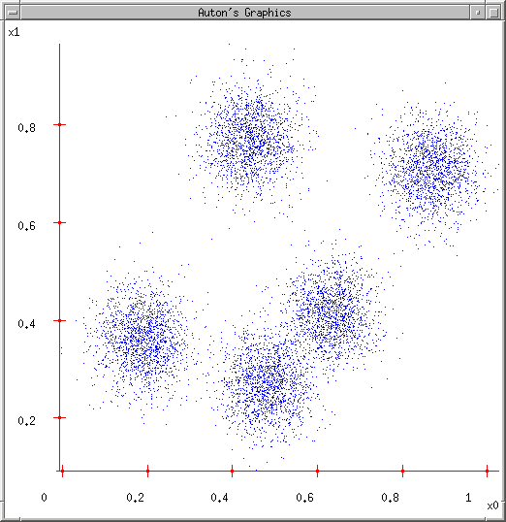
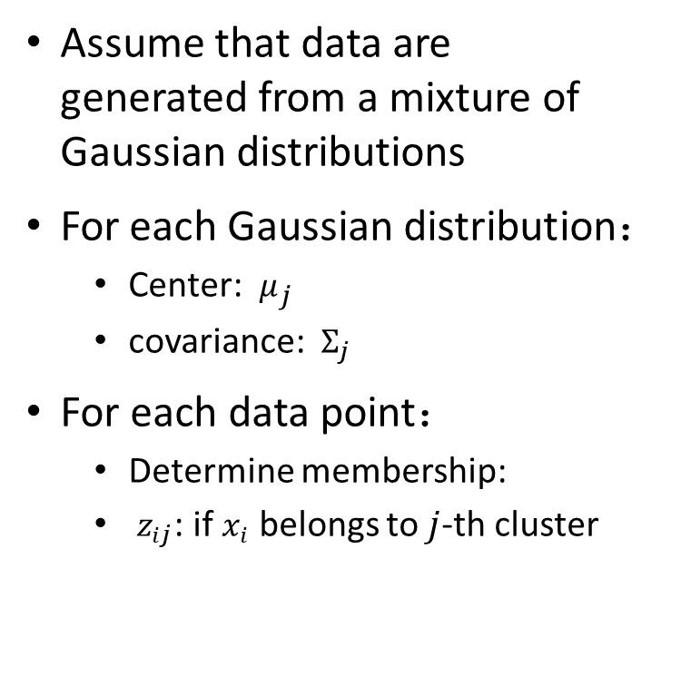
A Gaussian Mixture Model for Clustering
Assume that data are generated from a mixture of Gaussian distributions
For each Gaussian distribution：
Center: $μ_{j}$
covariance: $Σ_{j}$
For each data point：
Determine membership:
$z_{ij}$: if $x_{i}$ belongs to $j$-th cluster

Slide 12
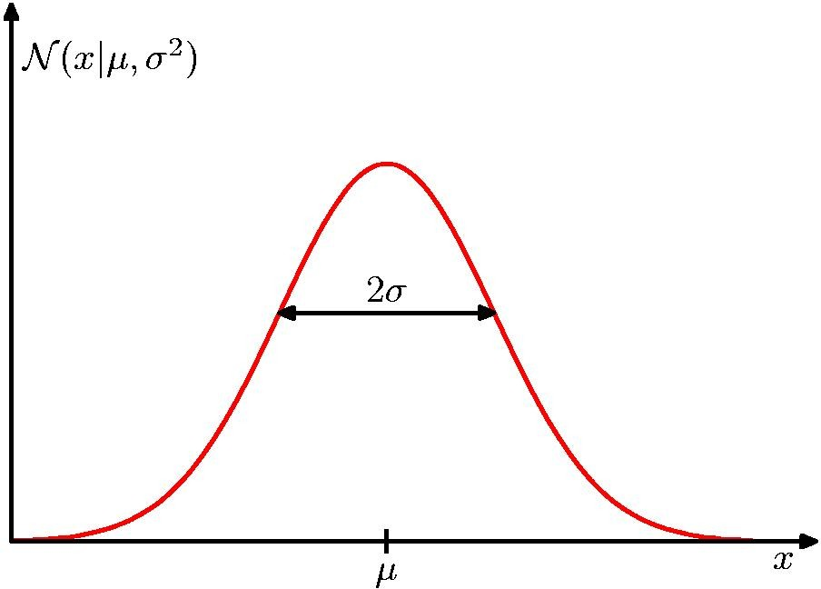
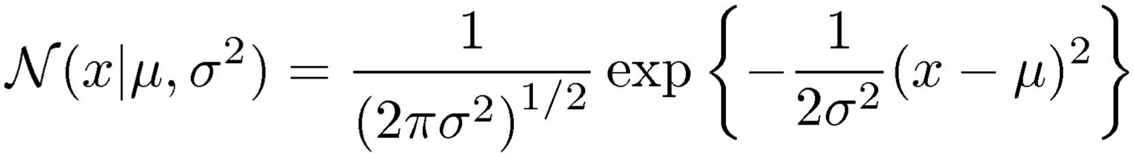
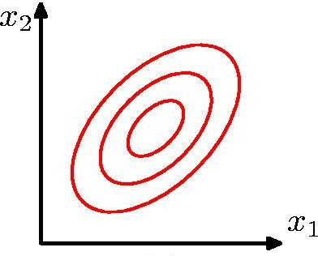

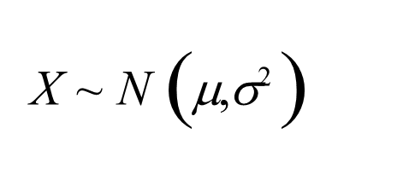

Review: Gaussian Distribution
Mean
Covariance Matrix

Slide 13
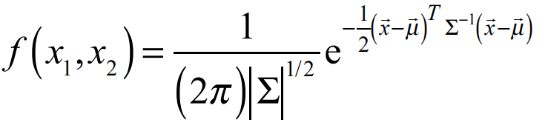
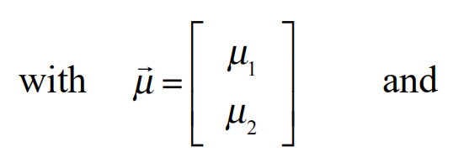
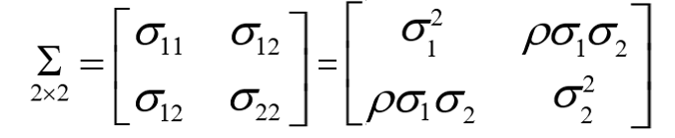

Review: the Bivariate Normal distribution
2×2
11

Slide 14
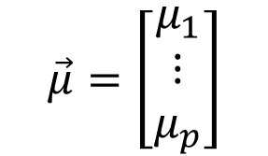
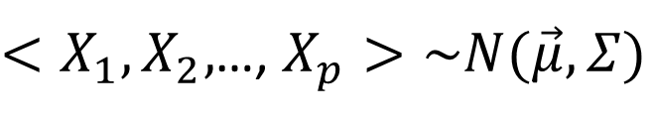
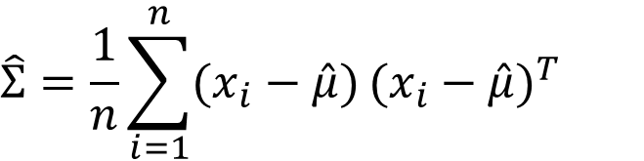
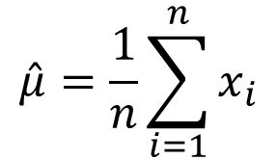
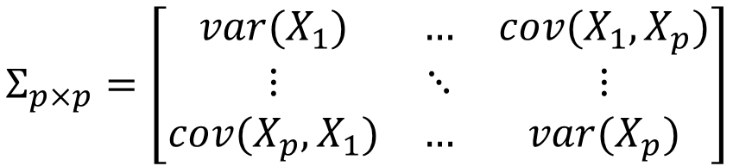
Review: use MLE to estimate p-D Gaussian
$<X_{1},X_{2},$…, $X_{p}>\sim N(\vec{μ},Σ)$
$$\vec{μ}=\left[\begin{matrix}μ_{1} \\ ⋮ \\ μ_{p}\end{matrix}\right]$$
$$Σ_{p×p}=\left[\begin{matrix}var(X_{1}) & … & cov(X_{1},X_{p}) \\ ⋮ & ⋱ & ⋮ \\ cov(X_{p},X_{1}) & … & var(X_{p})\end{matrix}\right]$$
$$\hat{μ}=\frac{1}{n}\sum_{i=1}^{n}{x_{i}}$$
$$\hat{Σ}=\frac{1}{n}\sum_{i=1}^{n}{(x_{i}−\hat{μ})}{(x_{i}−\hat{μ})}^{T}$$

Slide 15
Today: Gaussian Mixture Model
Review of Gaussian Distribution
GMM for clustering: basic algorithm
GMM connecting to K-means
Problems of GMM and K-means

Slide 16
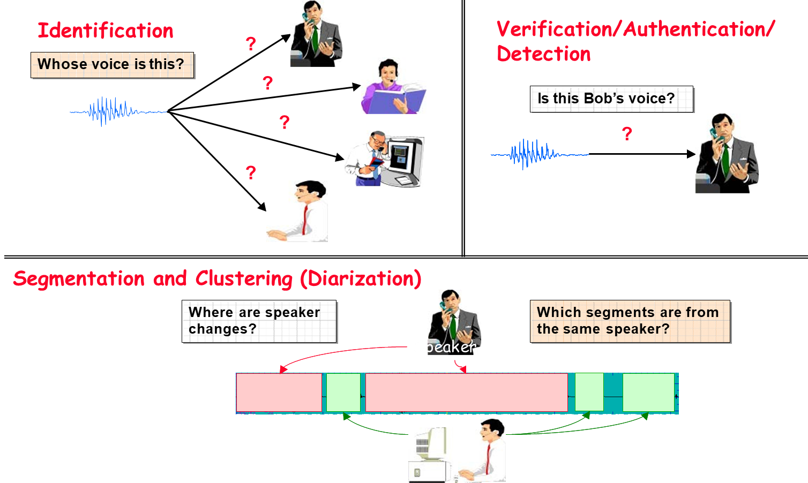
Application: Three Speaker Recognition Tasks

Slide 17
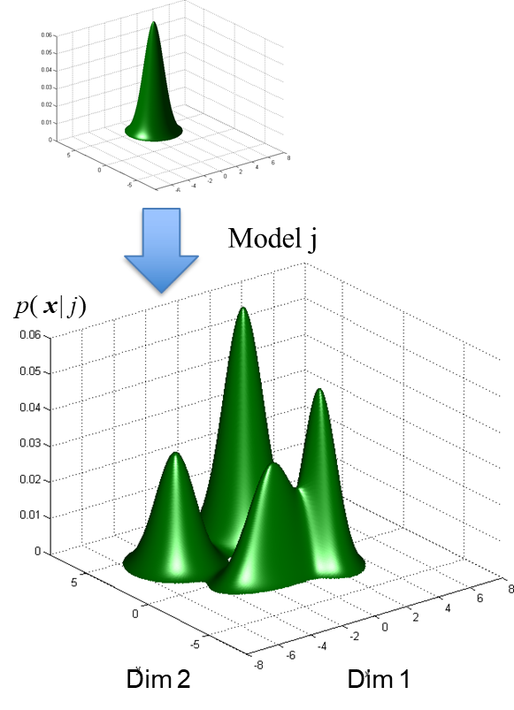
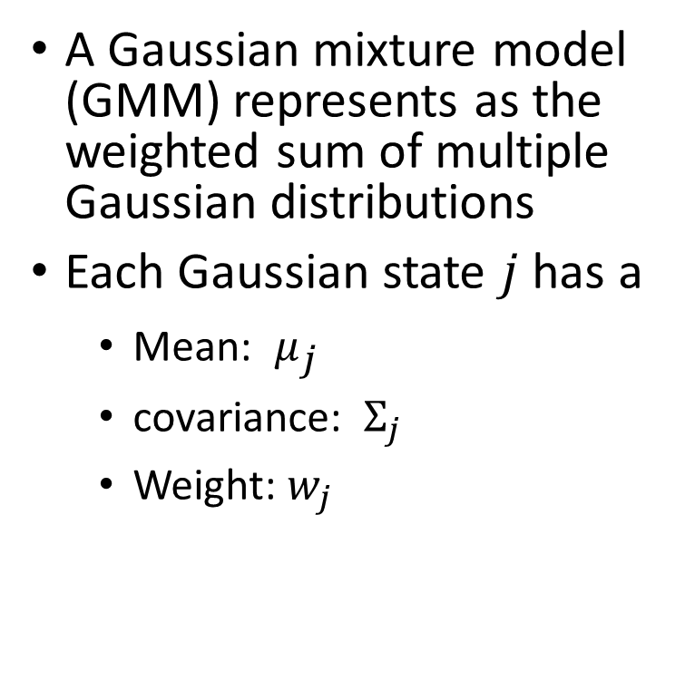
Application: GMMs for speaker recognition
A Gaussian mixture model (GMM) represents as the weighted sum of multiple Gaussian distributions
Each Gaussian state $j$ has a
Mean: $μ_{j}$
covariance: $Σ_{j}$
Weight: $w_{j}$

Slide 18
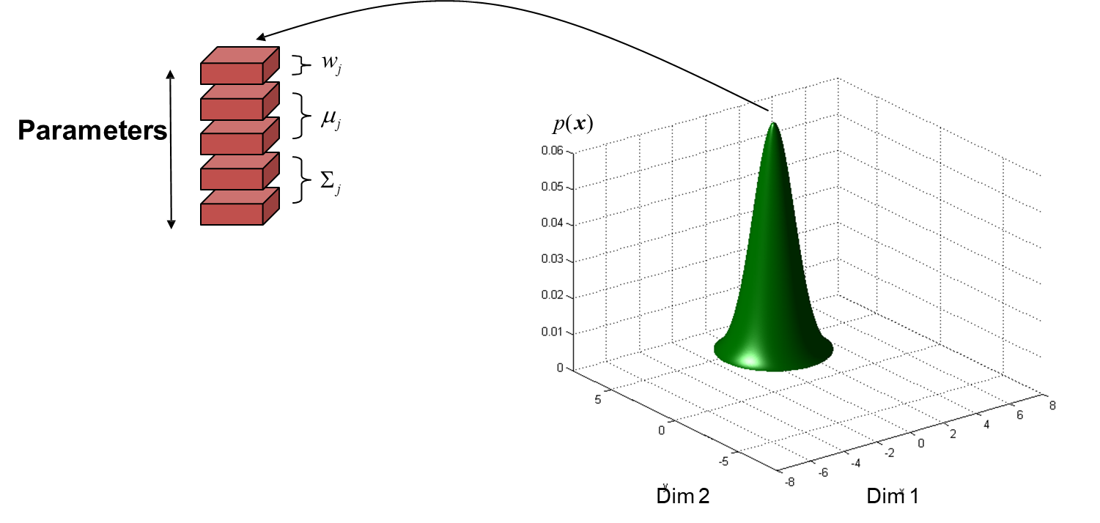
Recognition Systems Gaussian Mixture Models

Slide 19
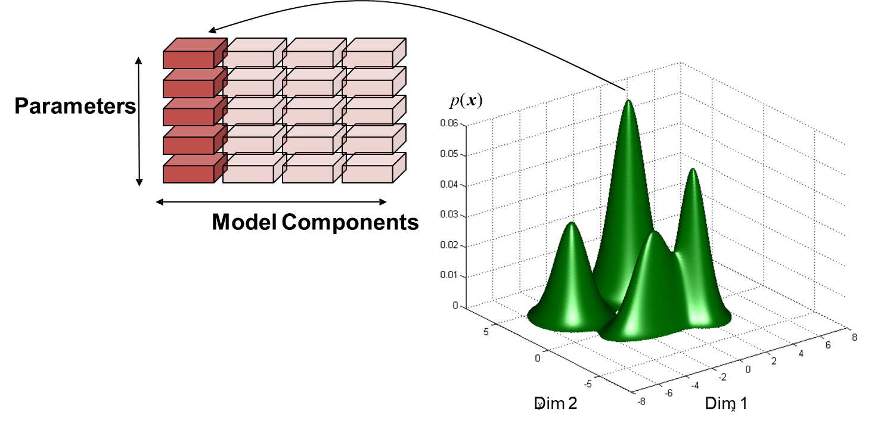
Recognition Systems Gaussian Mixture Models
j=1, 2, …, K

Slide 20

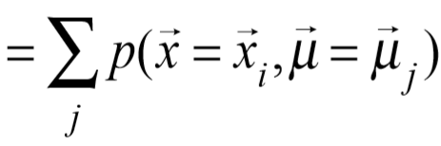
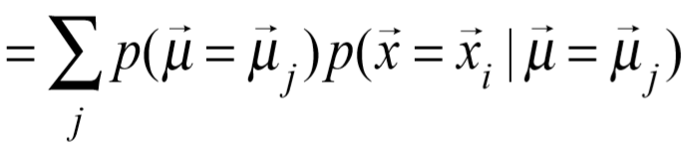
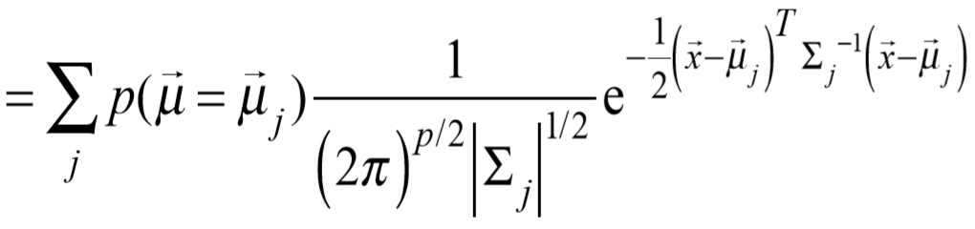
Learning a Gaussian Mixture
Probability Model
A Gaussian mixture model (GMM) represents as the weighted sum of multiple Gaussian distributions
Total low of probability
Chain rule

Slide 21
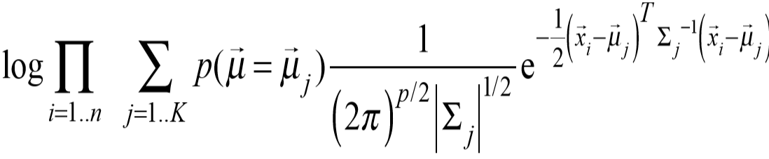
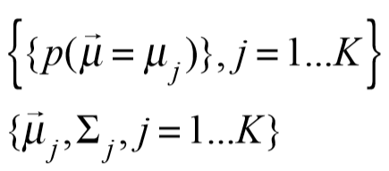
Max Log-likelihood of Observed Data Samples
Apply MLE to find optimal Gaussian parameters

Slide 22
Expectation-Maximization for training GMM
Start:
"Guess" the centroid and covariance for each of the K clusters
“Guess” the proportion of clusters, e.g., uniform prob 1/K
Loop
For each point, revising its proportions belonging to each of the K clusters
For each cluster, revising both the mean (centroid position) and covariance (shape)

Slide 23
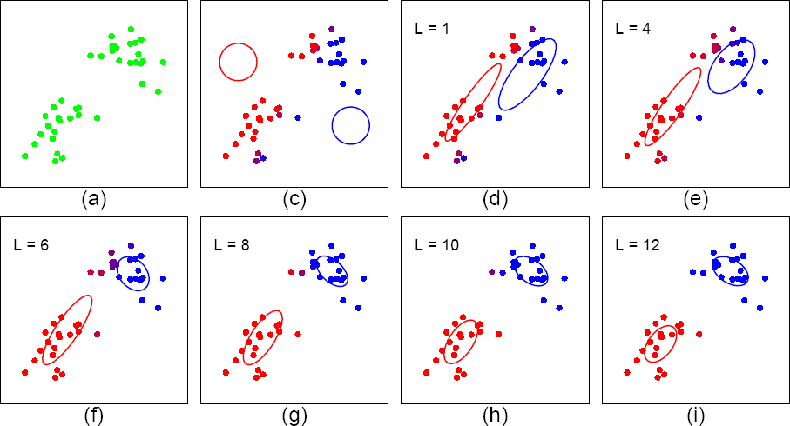
An example
each cluster, revising both the mean (centroid position) and covariance (shape)

Slide 24
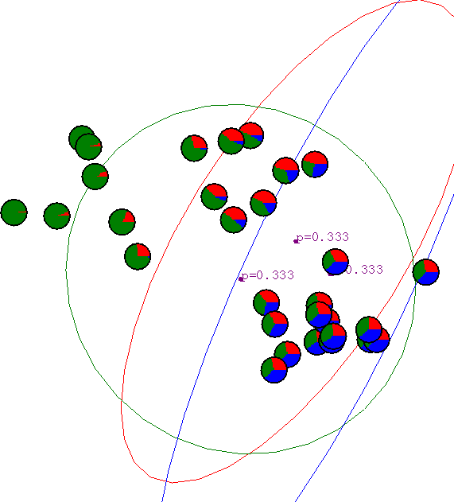
Another Example: Start

Slide 25
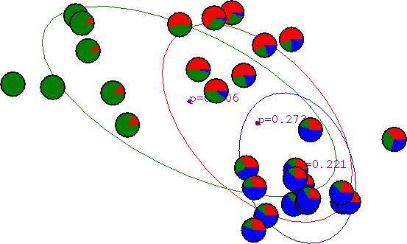
Another Example: After First Iteration
For each point, revising its proportions belonging to each of the K clusters
For each cluster, revising its mean (centroid position), covariance (shape) and proportion in the mixture

Slide 26

Another Example: After 2nd Iteration
For each point, revising its proportions belonging to each of the K clusters
For each cluster, revising its mean (centroid position), covariance (shape) and proportion in the mixture

Slide 27
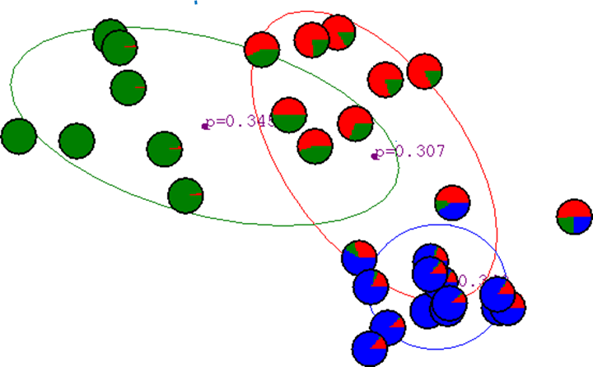
Another Example: After 3rd Iteration
For each point, revising its proportions belonging to each of the K clusters
For each cluster, revising its mean (centroid position), covariance (shape) and proportion in the mixture

Slide 28
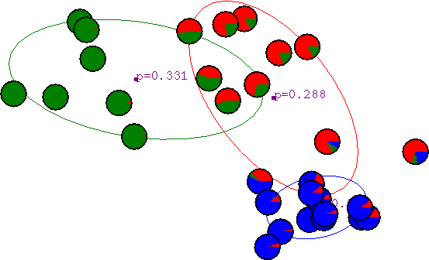
Another Example: After 4th Iteration
For each point, revising its proportions belonging to each of the K clusters
For each cluster, revising its mean (centroid position), covariance (shape) and proportion in the mixture

Slide 29
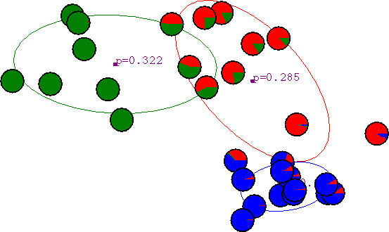
Another Example: After 5th Iteration
For each point, revising its proportions belonging to each of the K clusters
For each cluster, revising its mean (centroid position), covariance (shape) and proportion in the mixture

Slide 30

Another Example: After 6th Iteration
For each point, revising its proportions belonging to each of the K clusters
For each cluster, revising its mean (centroid position), covariance (shape) and proportion in the mixture

Slide 31
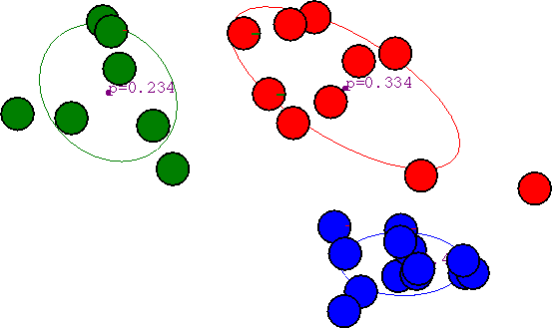
Another Example: After 20th Iteration
For each point, revising its proportions belonging to each of the K clusters
For each cluster, revising its mean (centroid position), covariance (shape) and proportion in the mixture

Slide 32
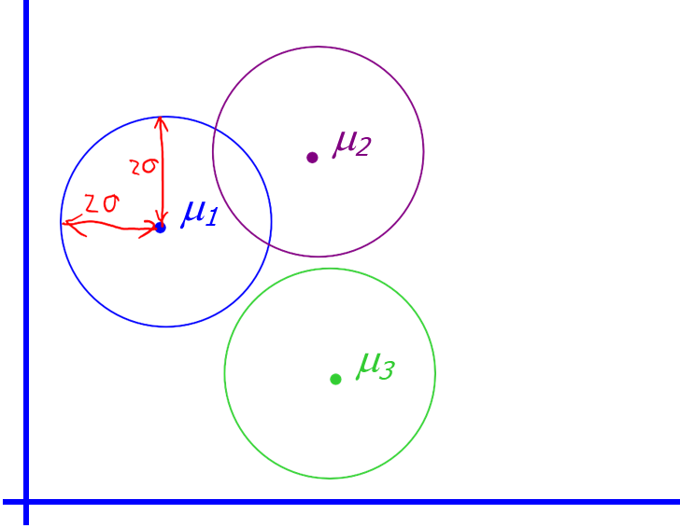
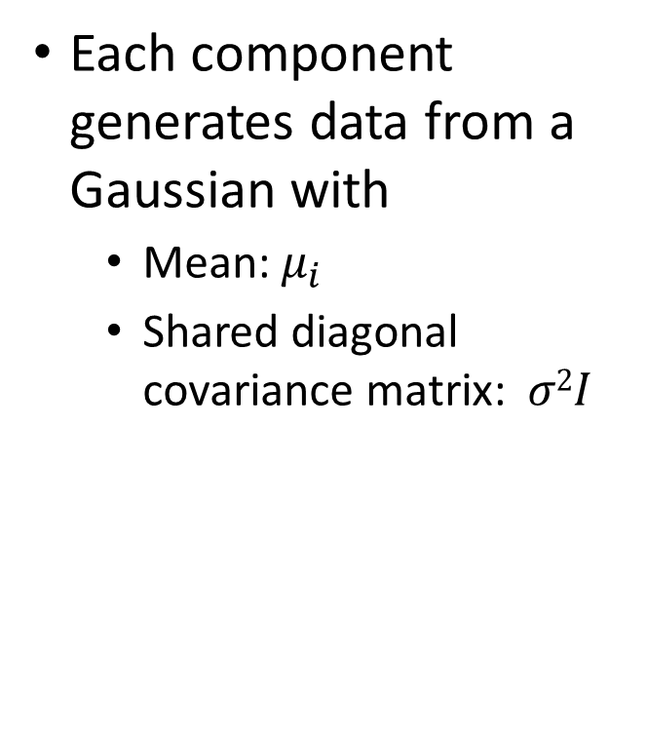
The Simplest GMM assumption
Each component generates data from a Gaussian with
Mean: $μ_{i}$
Shared diagonal covariance matrix: $σ2I$

Slide 33
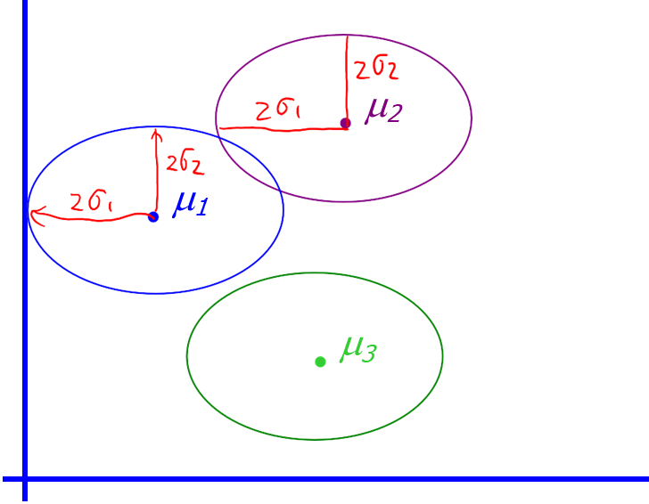
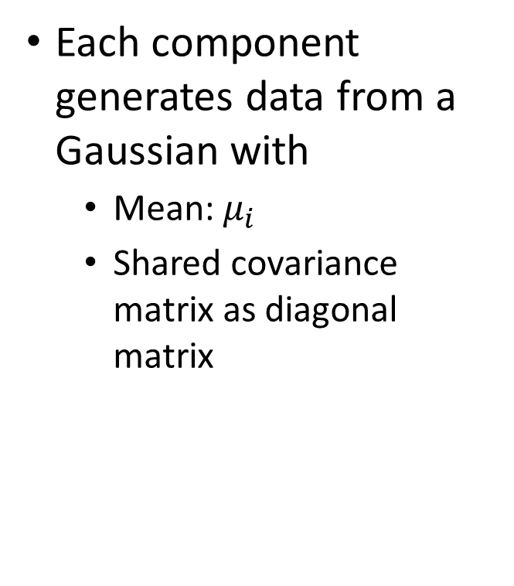
Another Simple GMM assumption
Each component generates data from a Gaussian with
Mean: $μ_{i}$
Shared covariance matrix as diagonal matrix

Slide 34
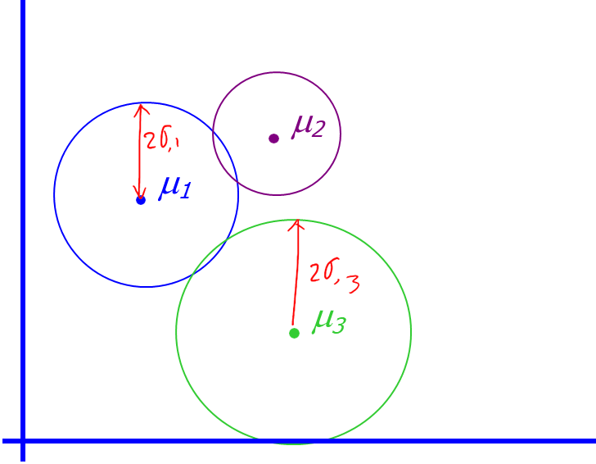
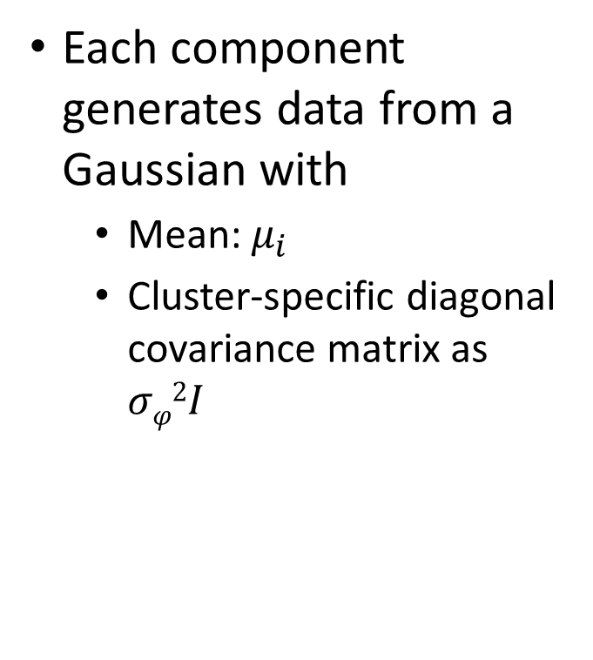
Another Simple GMM assumption
Each component generates data from a Gaussian with
Mean: $μ_{i}$
Cluster-specific diagonal covariance matrix as $σφ2I$

Slide 35
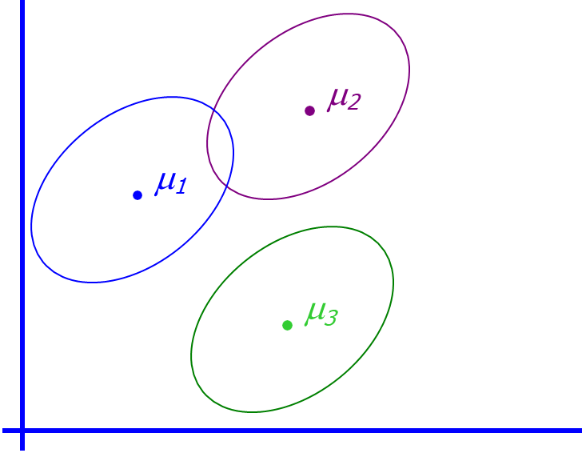
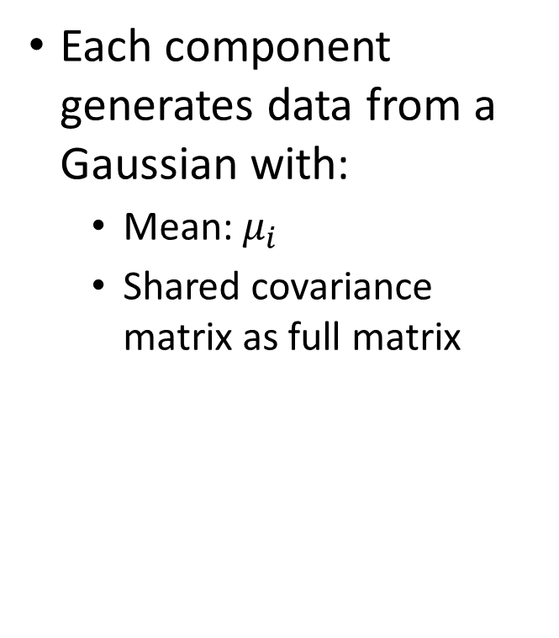
A bit More General GMM assumption
Each component generates data from a Gaussian with:
Mean: $μ_{i}$
Shared covariance matrix as full matrix

Slide 36
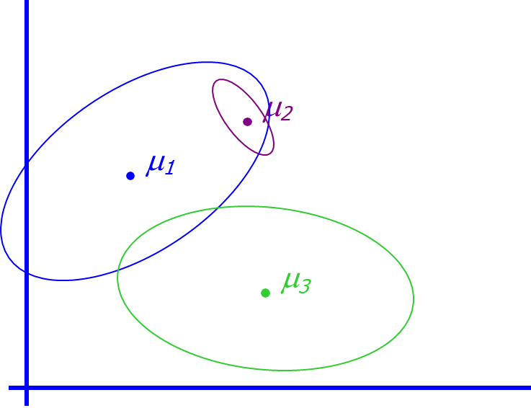

The General GMM assumption
Each component generates data from a Gaussian with:
Mean: $μ_{i}$
Covariance matrix: $Σ_{i}$

Slide 37
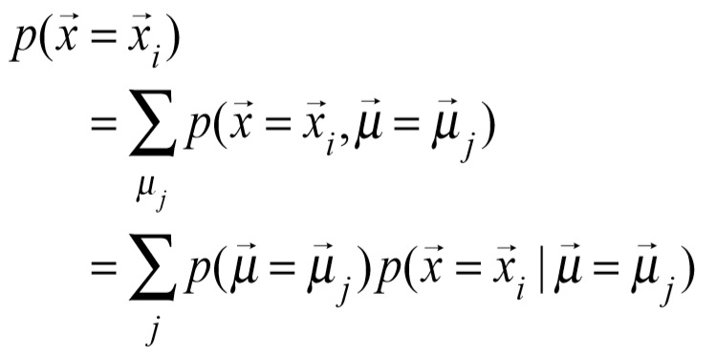
Concrete Equations for Learning a Gaussian Mixture (assuming with known shared covariance)

Slide 38

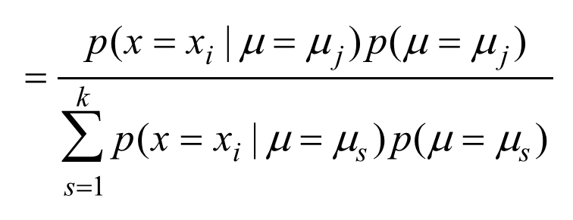
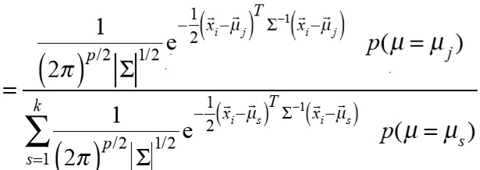
Learning a Gaussian Mixture (assuming with known shared covariance)
E-Step

Slide 39
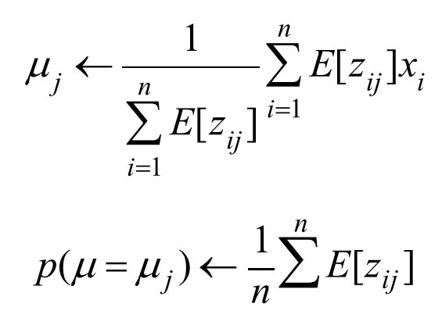
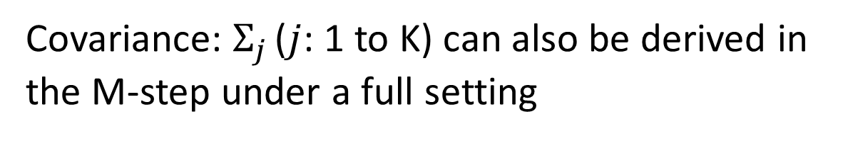
Learning a Gaussian Mixture (assuming with known shared covariance)
M-Step
Covariance: $Σ_{j}$ ($j$: 1 to K) can also be derived in the M-step under a full setting

Slide 40

M-step for Estimating (unknown Covariance Matrix)
more general, details in EM-Extra lecture

Slide 41
Recap: Expectation-Maximization for training GMM
Start:
"Guess" the centroid and covariance for each of the K clusters
“Guess” the proportion of clusters, e.g., uniform prob 1/K
Loop
For each point, revising its proportions belonging to each of the K clusters
For each cluster, revising both the mean (centroid position) and covariance (shape)

Slide 42
Today: Gaussian Mixture Model
Review of Gaussian Distribution
GMM for clustering : basic algorithm
GMM connecting to K-means
Problems of GMM and K-means

Slide 43





Recap: K-means iterative learning
E-Step
M-Step

Slide 44
Compare: K-means
The EM algorithm for mixtures of Gaussians is like a "soft version" of the K-means algorithm.
In the K-means “E-step” we do hard assignment:
In the K-means “M-step” we update the means as the weighted sum of the data, but now the weights are 0 or 1

Slide 45




Compare: K-means & GMM
K-means:
GMM:
K-Mean only detect spherical clusters.
GMM can adjust its self to elliptic shape clusters.

Slide 46

GMM Clustering

Slide 47
Today: Gaussian Mixture Model
Review of Gaussian Distribution
GMM for clustering: basic algorithm
GMM connecting to K-means
Problems of GMM and K-means

Slide 48

Unsupervised Learning: not as hard as it looks
Sometimes easy
Sometimes impossible
and sometimes in between

Slide 49

Problems (I)
Both k-means and mixture models need to compute centers of clusters and explicit distance measurement
Given strange distance measurement, the center of clusters can be hard to compute

Slide 50

Problems (II)
Both k-means and mixture models look for compact clustering structures
In some cases, connected clustering structures are more desirable

Slide 51

e.g. Image Segmentation through minCut

Slide 52
References
https://qiyanjun.github.io/2019f-UVA-CS6316-MachineLearning/
Hastie, Trevor, et al. The elements of statistical learning. Vol. 2. No. 1. New York: Springer, 2009.
Big thanks to Prof. Eric Xing @ CMU for allowing me to reuse some of his slides
Big thanks to Prof. Ziv Bar-Joseph @ CMU for allowing me to reuse some of his slides
clustering slides from Prof. Rong Jin @ MSU

Slide 53
Thanks for listening

